Slide 1

Capture The Flag
NAME: RALPH RODRIGUEZ
TEAM Name: GROUP 3

Slide 2
Introduction
The CTF Problem
Introduction to the Problem
Working Toward a Solution
Arriving at The Solution
Strategies, Pitfalls, Lessons Learned
Workplace Relevance
Summary
Demo
Notes:
Tell your audience what you intend to cover in your project. This is the purpose of your communication.
In Section 1, provide some background of the category of your CTF challenge.
Introduce the audience to the problem and tell us how you plan to approach it and get the solution.
In Section 2, cover the steps you used to solve the problem. This may cover multiple solves.
In Section 3, talk about how you found the solution and discuss the pitfalls and recommendations when facing these types of problems.
In Section 4, talk about the relevance of Capture the Flag problems to the workplace and your job role.

Slide 3
CTF The Problem :
CHALLENGE 6: USE THE CAPTURE FILE PROVIDED TO DETERMINE DARTH VADER'S PASSWORD.
Passwords are often misplaced or forgotten — even by high-profile users. This challenge simulates a realistic scenario where recovering a lost password is critical.
We explore a fast and effective recovery method using forensic tools. By analyzing network traffic from a capture file, we extract key data in just minutes.
Notes:
Before presenting this problem, discuss the category of the CTF challenge and the relevant skills needed to solve this type of problem.
Answer the four questions below in your slide and make these questions your talking points.
Describe the category of question that you attempted.
What is the important background knowledge needed?
How does this relate to the Ethical Hacking course?
What lab in the course covered the topic from this CTF problem?

Slide 4
CTF The Problem :
CHALLENGE 6: USE THE CAPTURE FILE PROVIDED TO DETERMINE DARTH VADER'S PASSWORD.
EXECUTION FLOW
PACKET ANALYSIS
HASH EXTRACTION
PASSWORD RECOVERY
Notes:
Before presenting this problem, discuss the category of the CTF challenge and the relevant skills needed to solve this type of problem.
Answer the four questions below in your slide and make these questions your talking points.
Describe the category of question that you attempted.
What is the important background knowledge needed?
How does this relate to the Ethical Hacking course?
What lab in the course covered the topic from this CTF problem?

Slide 5
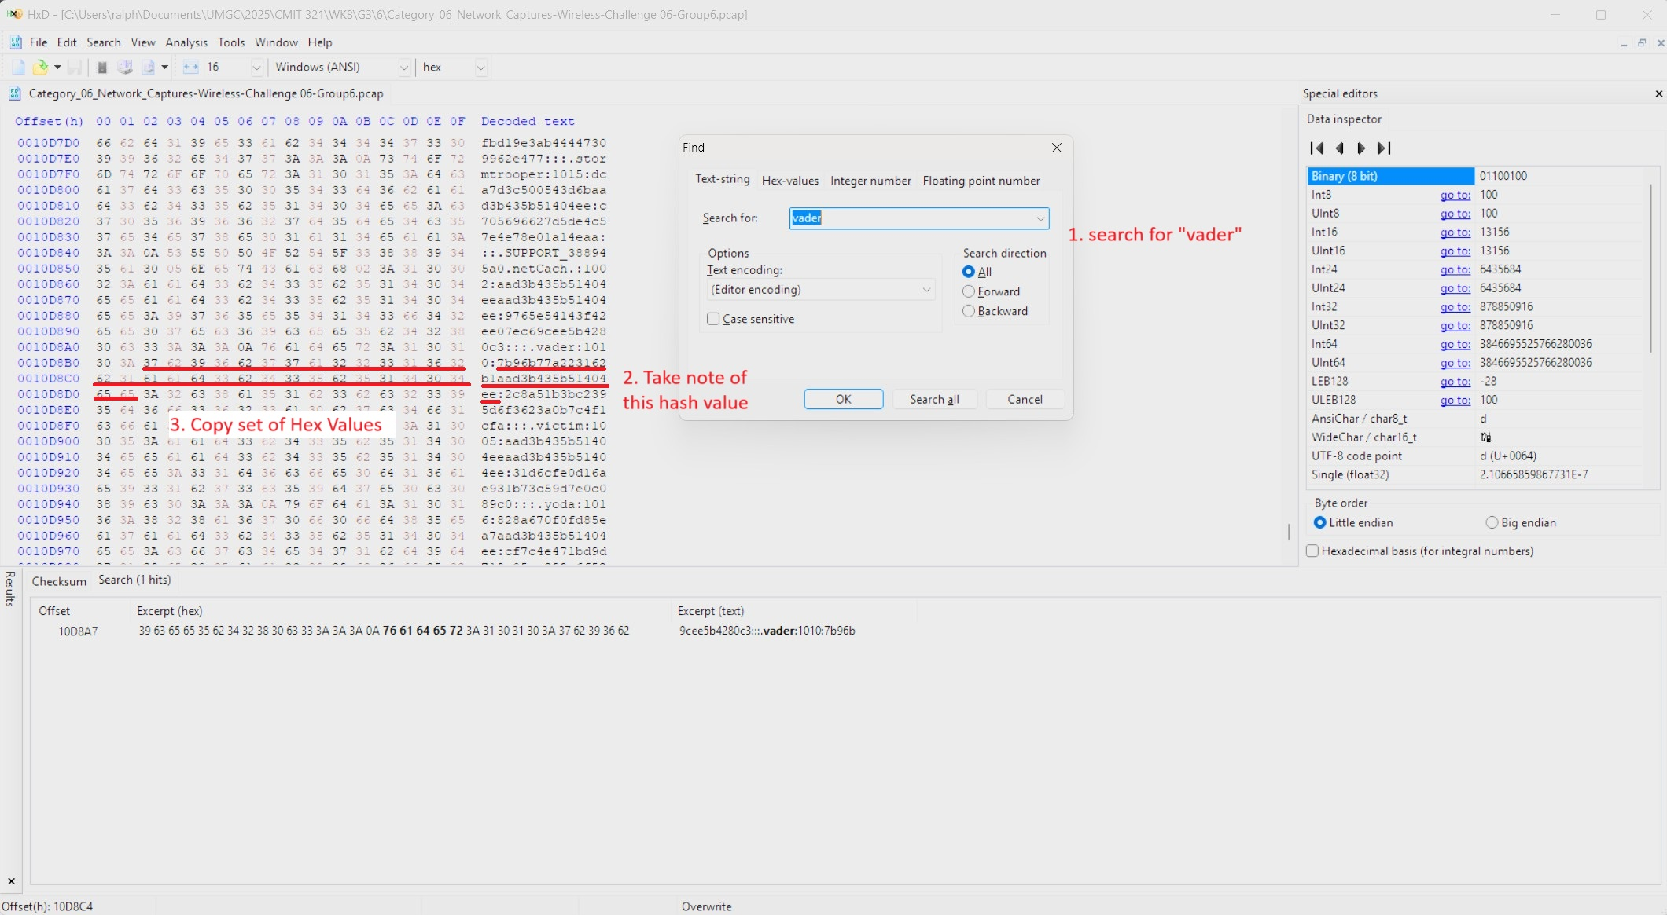
Introduction to the Problem
With a Hex editor open the PCAP file and search for "Vader'
Take note of the HASH value and copy the HEX values
Notes:
Sample text for narration: We open the .pcap using Wireshark and set a filter for the File Transfer Protocol (FTP) using “ftp” in the display filter box and click Apply to show only the FTP traffic in the capture file.

Slide 6
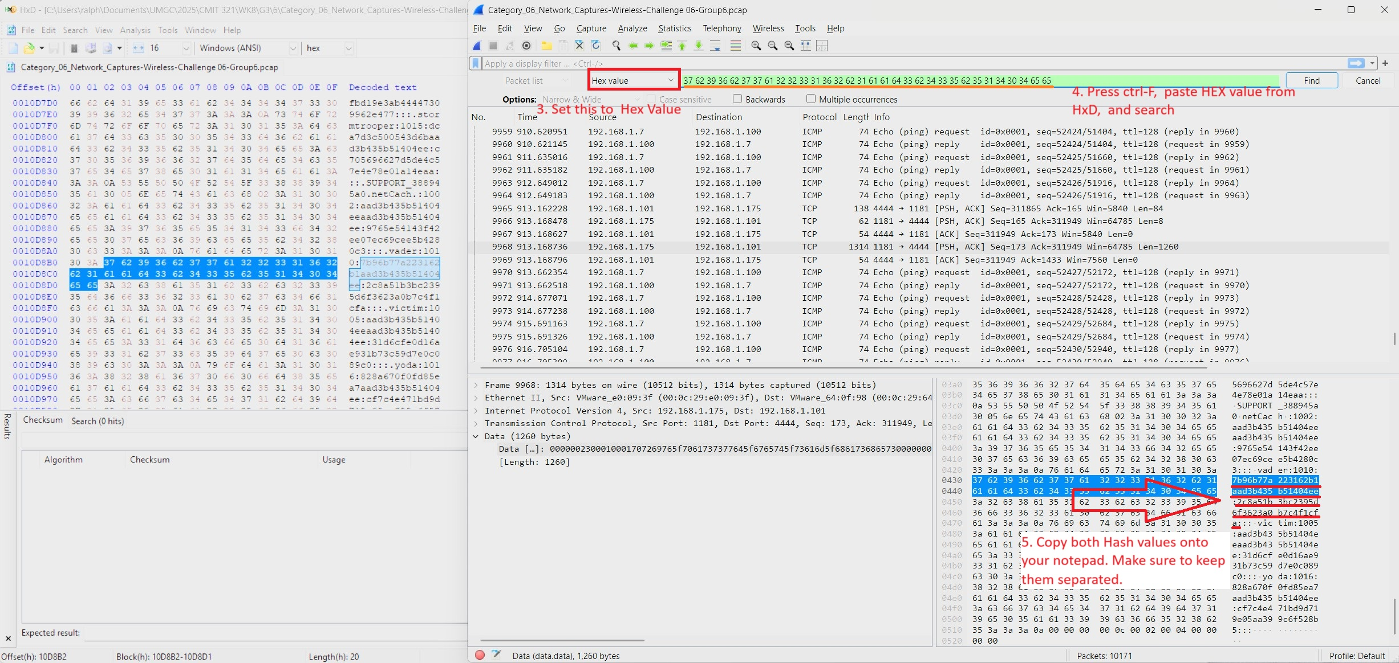
Working Toward A Solution
Open the same file with WireShark & search for the same HEX value
Verify the same HASH value from the left (HxD) are the same as with the ones on the right (WireShark)
Copy the 2 HASH values from Wireshark
Notes:
Sample text for narration: Right-click one of the packet frames (below frame #71) and choose the Follow > TCP Stream to show the conversation between the FTP server and the client machine. Note: TCP is the Transmission Control Protocol, a connection-oriented protocol.
You may choose to add additional slides.

Slide 7
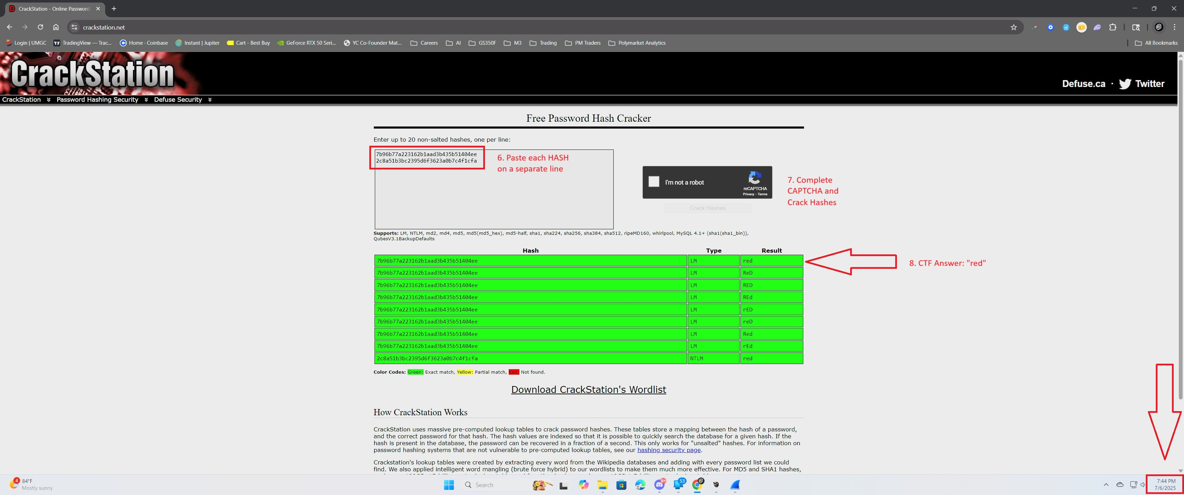
Arriving at the Solution
Open a web browser and visit crackstation.net
Paste each HASH value on a separate line, complete the CAPTCHA, and click "Crack Hashes"
Navigate to the results column and the answer: "red"
Notes:
Sample text for narration: In the Follow TCP Stream pop-up window, search for the flag, in the format of UMGC-XXXXX (below, UMGC-ABC123).
Write out the flag in your documentation. Your screenshot of the Follow TCP Stream pop-up window must include the date/time from the host system. Each student is responsible for providing at least one screenshot as shown below.

Slide 8
Strategies, Pitfalls, Lessons Learned
Faster Strategy: The hash can be copied directly from the hex editor (HxD) and submitted to CrackStation without needing Wireshark — saving time.
Common Pitfall: Since the file is a .pcap, it's natural to open it in Wireshark first. However, searching for "vader" in Wireshark doesn’t return useful results — HxD is more effective in this case.
Lesson Learned: It’s important to understand the strengths and limitations of both Wireshark and HxD. Choosing the right tool for the task makes a big difference in solving CTF challenges efficiently.
Notes:
In this section, discuss some of the strategies you used to solve your CTF problem, as well as some of the pitfalls that can lead to the wrong path. This will all be part of the lessons learned section that will help you know how to approach this kind of problem.

Slide 9
Workplace Relevance
Real-World Packet Analysis: Skills in analyzing .pcap files using tools like Wireshark and hex editors are directly applicable in incident response and threat hunting.
Hash Recognition and Cracking: Understanding how to identify and crack password hashes helps with password auditing, penetration testing, and verifying credential leaks.
CTF Practice = Hands-On Readiness: Capture the Flag (CTF) challenges simulate real cybersecurity problems, building muscle memory for tasks like data extraction, protocol analysis, and threat detection.
Notes:
In this section, discuss how you think Capture the Flag competitions can benefit you in the workplace.

Slide 10
Summary
In these challenges, I successfully extracted and cracked a password from a .pcap file using a combination of HxD (hex editor) and online tools. Although Wireshark is a go-to tool for packet analysis, this scenario highlighted the importance of choosing the right tool for the task. HxD provided a more direct path to the solution. I learned that understanding how to navigate raw data, identify hashes, and use external resources like CrackStation can significantly speed up problem-solving. This hands-on exercise not only strengthened my technical skills but also deepened my understanding of packet-level data analysis, which is highly relevant in cybersecurity roles such as threat analysis, digital forensics, and penetration testing.
Notes:
This is your summary and your last opportunity to connect with your audience.
Do not merely repeat your agenda topics. Add one to two important details about each main point to review for your audience.
What is/are the main takeaway(s)?

